Slide 1
Department of Computer Science
CS F364 – DESIGN AND ANALYSIS OF ALGORITHMS
LECTURE – GREEDY METHOD
PORTIONS: As specified in handout and the contents taught in class. Class notes is must. Refer to the textbook as mentioned in handout
PLEASE NOTE THAT PPT IS JUST AN ADDITIONAL REFERENCE.

Slide 2
Topic- Greedy Approach
The general method
Knapsack problem
Tree vertex splitting
Job sequencing with deadlines
Minimum cost spanning tree

Slide 3
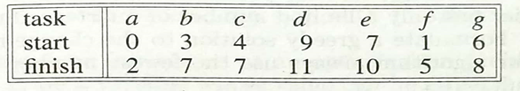
General method
Ex: 7 Tasks

Slide 4
Knapsack problem
0/1 knapsack
Fractional knapsack

Slide 5
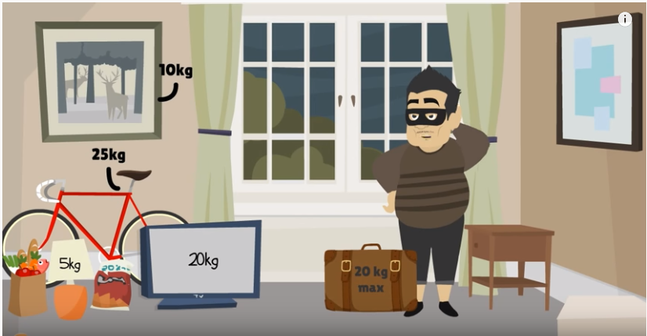
0/1 knapsack

Slide 6

Greedy knapsack: Fractional knapsack

Slide 7



Greedy knapsack: Fractional knapsack
Bag size:20kg Object | 1 | 2 | 3
Profit | 25 | 24 | 15
weight | 18 | 15 | 10

Slide 8
Example Bag Size: 15 kg
Object | 1 | 2 | 3 | 4 | 5 | 6 | 7
Profit | 10 | 5 | 15 | 7 | 6 | 18 | 3
weight | 2 | 3 | 5 | 7 | 1 | 4 | 1

Slide 9
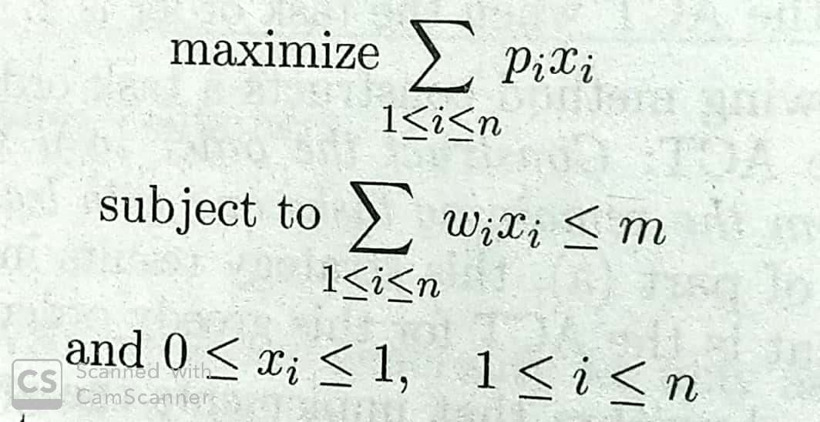
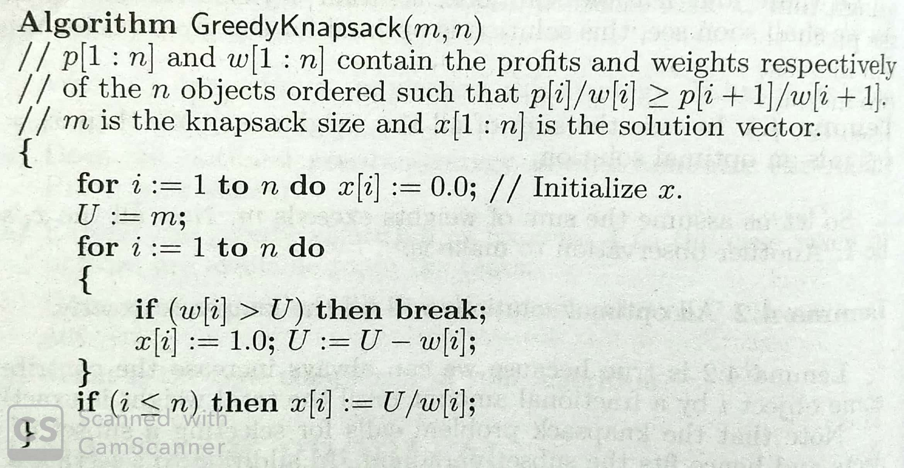
Knapsack

Slide 10
Tree Vertex Splitting
Keywords to know
Source node
Sink node
Indegree
Outdegree
Undefined weight
Forest
Tree

Slide 11
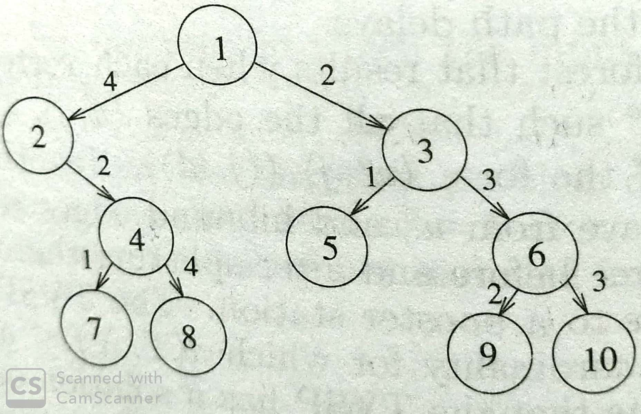
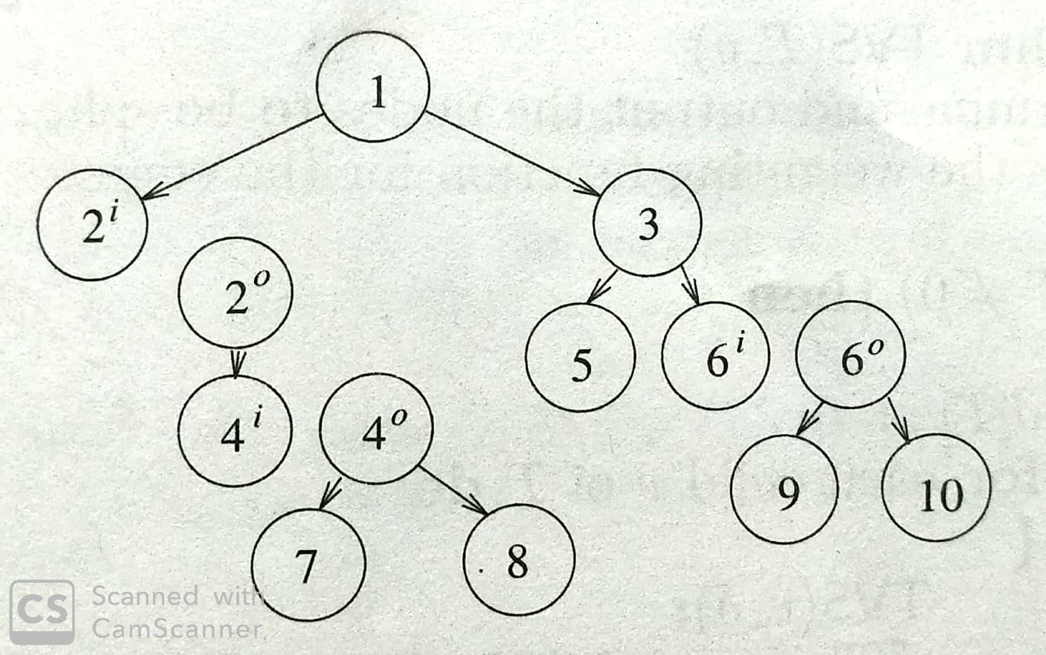
Tree Vertex Splitting

Slide 12
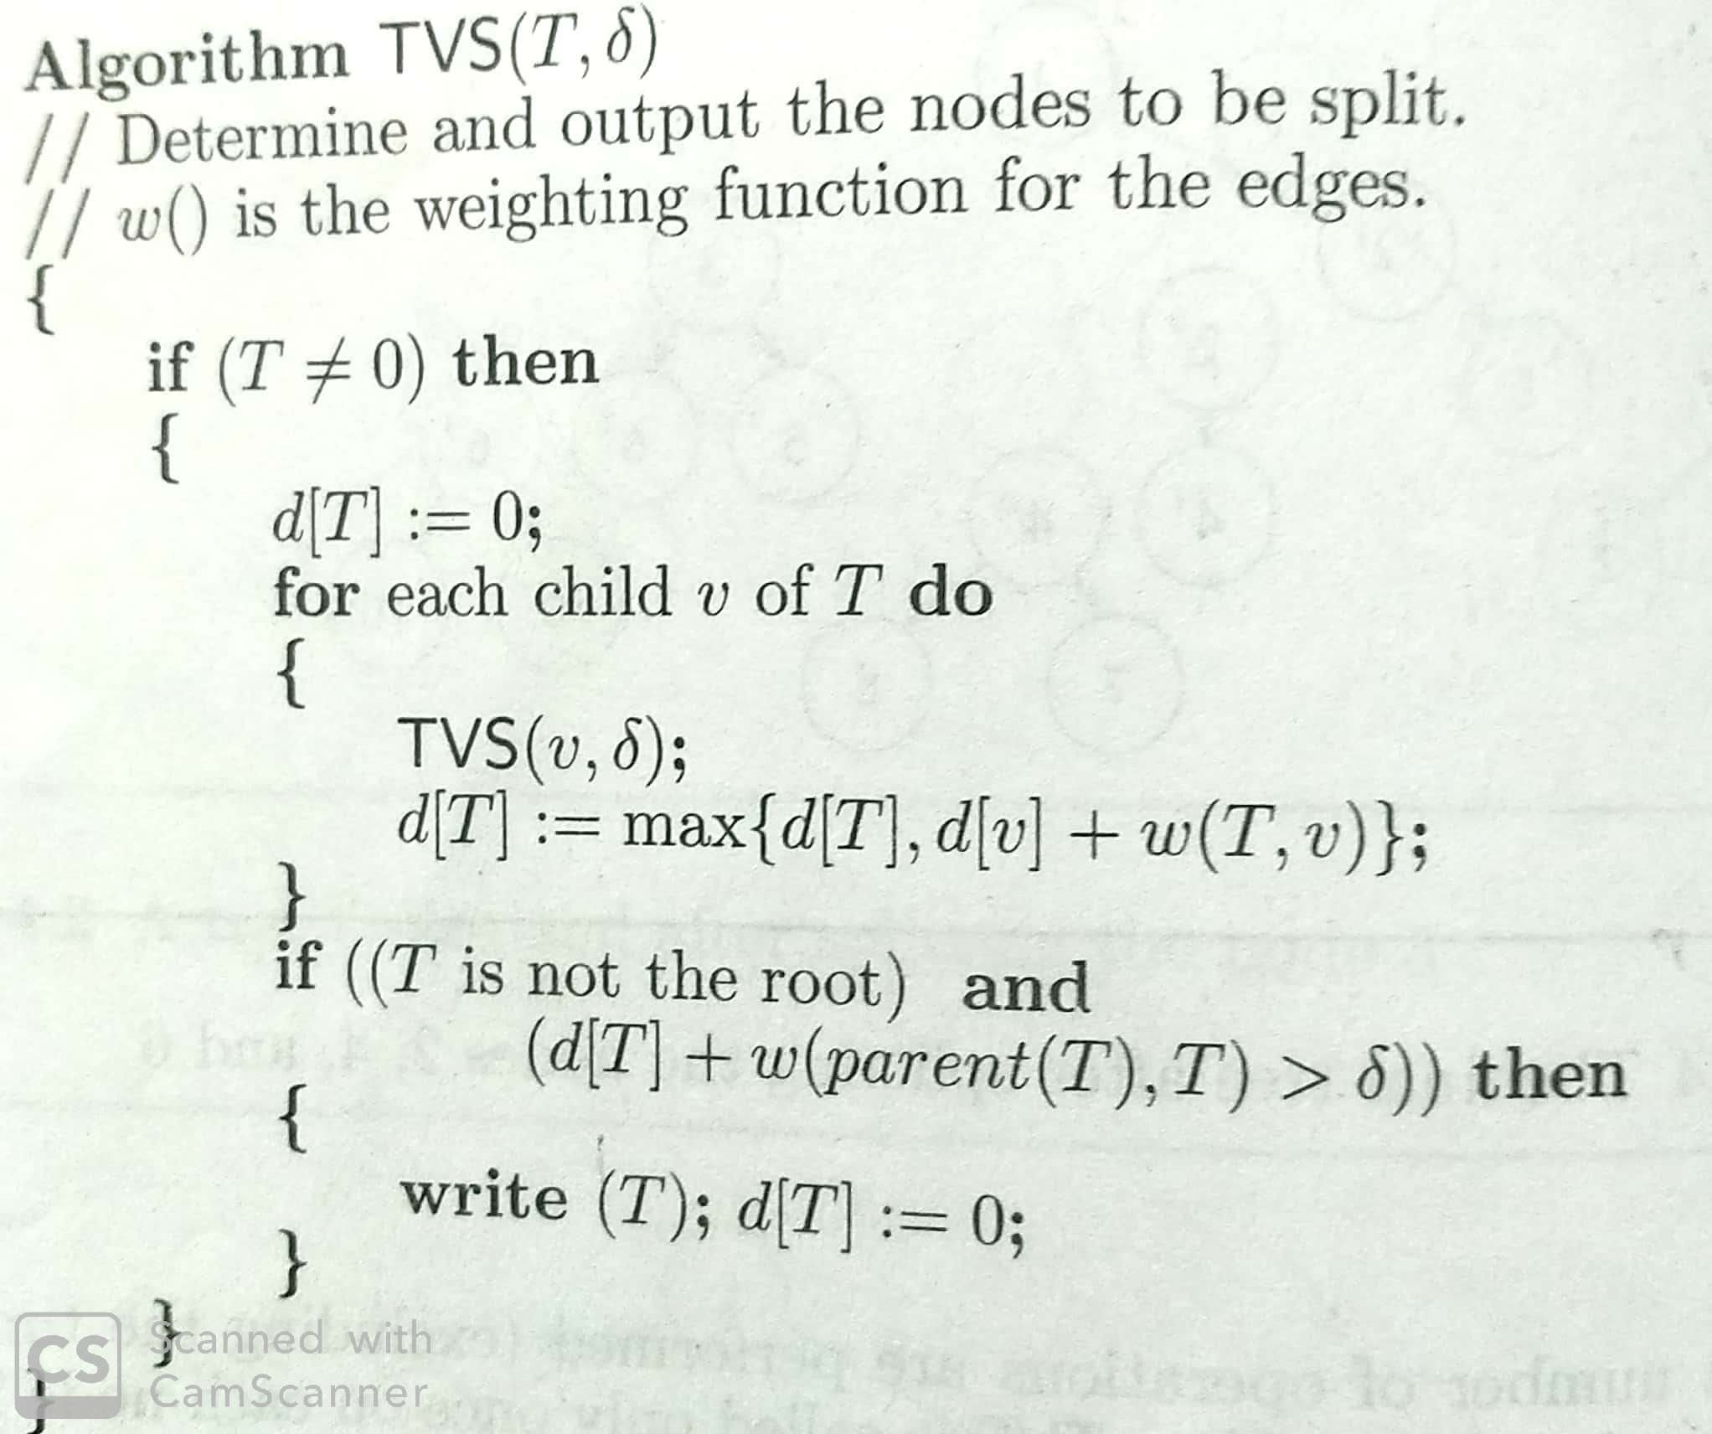
Tree vertex splitting algorithm

Slide 13
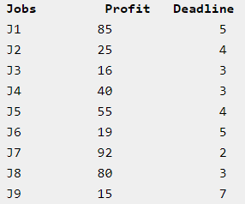
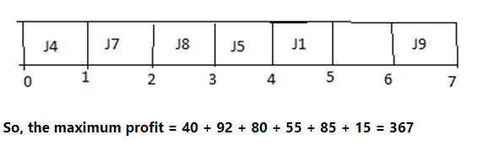
Job scheduling
Job sequencing is the set of jobs, associated with the job i where deadline di >= 0 and profit pi > 0. For any job i the profit is earned if and only if the job is completed by its deadline. To complete a job, one has to process the job on a machine for one unit of time. Only one machine is available for processing the jobs.

Slide 14
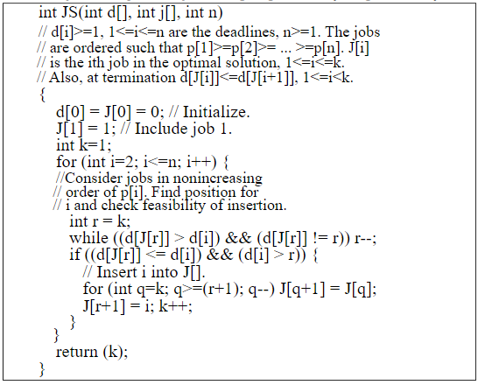
Job scheduling with deadlines- version 1

Slide 15
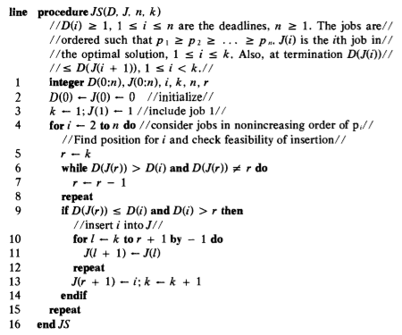
Job scheduling with deadlines- same algorithm for better understanding

Slide 16
THANK YOU

